Slide 1
GENERATIVE AI FOR 3D PRINTING
MaCAD Thesis | James Foo and Dom Large

Slide 2
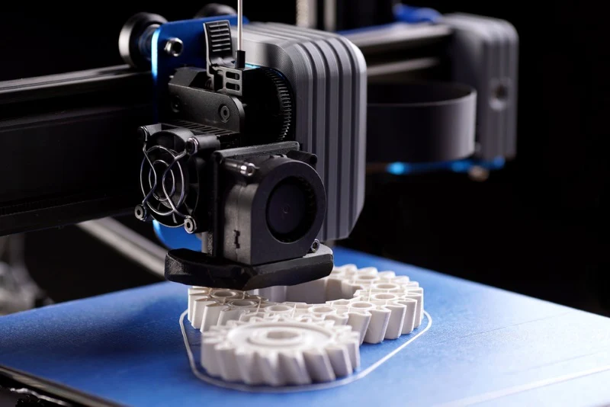
Research Question
Feasibility of Machine Learning for Voice-to-Part 3D Printing
Question: Is it possible to apply machine learning to develop a model that can successfully model and prepare a part for 3D printing, using only a human voice prompt?
Objective: To explore the feasibility and practical implementation of a machine learning model that can take a voice prompt, convert it into a 3D model, and prepare it for 3D printing.

Slide 3
Methodology
Voice to Text Prompt
LLM training for successful prompt generation from Voice
3D Object Generation
3D GANS model with a pixel size and space based on 3D printer capabilities
[Comfy UI method that’s already been started]
Gen AI / Existing Models
3D Diffusion Model
Validate Exported Models (Closed Meshes)
3D Printing
Integration: Connect the system with 3D printers via REST APIs like OctoPrint.
Automation: Automate the file upload and printing initiation process.
Evaluation: Ensure reliable and error-free communication with 3D printers.

Slide 4
Tech Stack
Python with VSCode / COLAB
Used for cleaning data and training the model
ComfyUI
Model Generation based on Voice - Text Prompts
Grasshopper
Used for generating objects and data for training
Python to Communicate with Printer / GCode
3D printing connection and execution

Slide 5
Milestones
PROMPT / OBJECT GENERATION
3D PRINTING
Week 1:
Research
Finalize Methodology
Week 2:
Building initial grasshopper definition for training / Begin Model training for Voice to Text Prompt
Week 3:
Refining definition and begin collecting dataset
Week 4:
Initial training and feature optimization
Week 5:
Finalize features and begin training final dataset
Week 1:
Week 2:
Week 3:
Week 4:
Week 5:
Begin 3D model outputs / Validate model for print
Week 6:
Finish data collection, train model, tune model
Week 7:
Combine with 3D printing
Week 8:
Deployment method for combined AI models
Week 9:
Final Touch ups
Creating presentations drawings
Week 10:
Presentation Week
Week 6:
Begin printing tests (manual process)
Week 7:
Continue Test Prints / Begin printer communication stack
Week 8:
Print Via Machine Communication (Preliminary)
Week 9:
Successful Printing via model with no interaction
Week 10:
Successful Printing via model with no interaction

Slide 6
EXTRA / FEEDBACK
LLM may be challenging because of quantities
Valid geometry generation (focus in beginning)
Start with primitives for training (Grasshopper?)
Begin with parametric grasshopper model of chair
Inputs would be dimensions for prompt generation
Scale will be a challenge
Which model to train / sensitive for dimensions
Simple model to start where dimensions are only variant (find out if numbers will be a problem)
Possible pivot
Voice to text to Revit Families

Slide 7
Text to geometry to gcode
task1 ) figure out whichg gen model is sensitive to dimensions
task2 ) pivot to revit text to family if no solution found

Slide 8
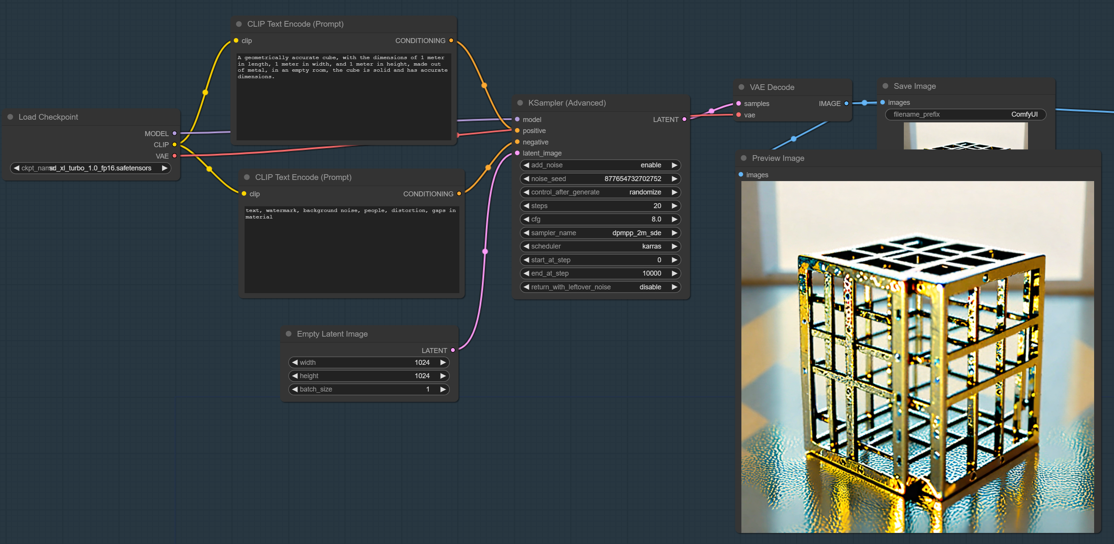
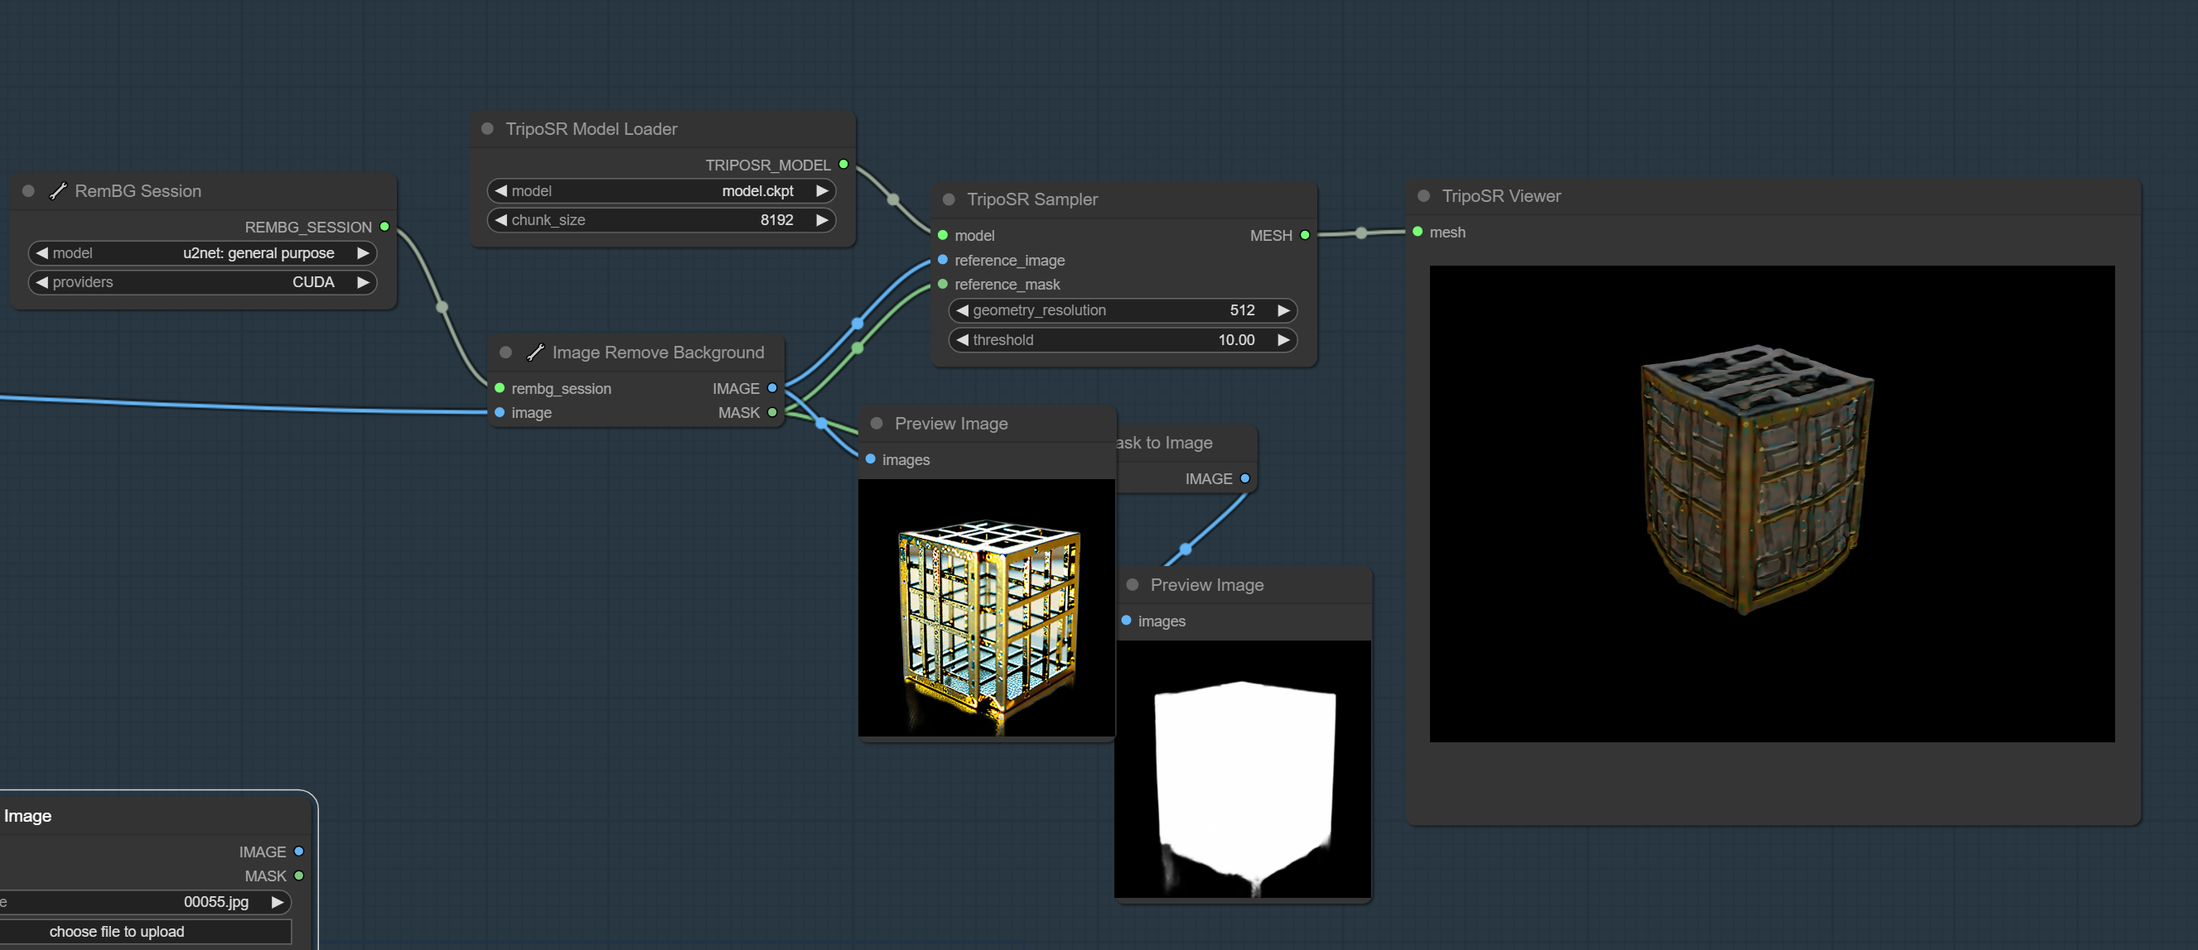
Week 1
Next Steps (Gabriella):
start the pivot to plan B: AIUI speech to instruction for revit or similar
break down the tech stack and work at opposite ends to develop compatible tooling (probably interface with Rhino.Inside)
Focus on one family as a PoC

Slide 9
Next Steps / Tasks
Dom Tasks
Speech-to-Text
Create Working Colab Notebook
Audio File to Text
Recording to Text
Text to Usable Variables
GH Definition of Table for Revit Inside
Focus on Table then merge with Inside approach
Variables from Notebook to GH
Python component in grasshopper??
James Tasks
Revit API research
best approach for family creation
Begin Revit Inside Approach in GH
will merge with Table creation later
3D Object Generation possibility
Exploration / Early implementation

Slide 10
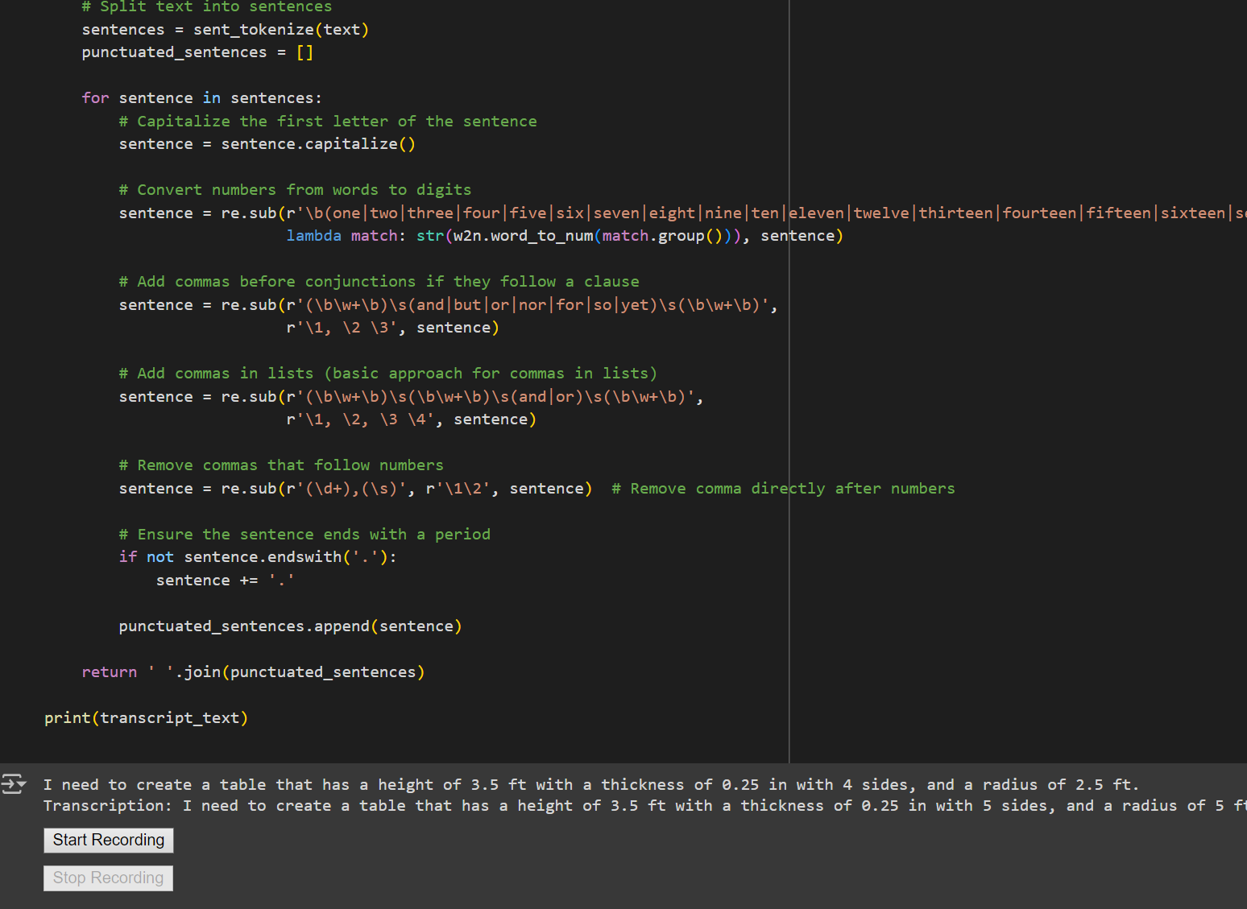

Dom Progress
Speech to Text Prompt - Python
Part 1 – Dependencies
Speech Recognition / Word2Number / nltk used to record & transcribe speech live in Colab
Part 2 – Record Audio
Audio Recorded with Start / Stop buttons in notebook
Part 3 – Organize / Fix prompt
Numbers / Grammatical improvements made
Part 4 – Find & Assign Variable Values
Table Attribute Variables identifies and assigned correct values
Ex Prompt / I need to create a Table that has a Height of 3.5 Ft with a Thickness of 0.25 In with 5 Sides , and a Radius of 5 Ft the Table must have a corner Fillet of 0.41 Inches , and overall Edge Fillets of 0.1 Inches , for the Legs make the Leg Radius 0.2 Inches with a few of 1.25 Degrees , and the Taper of 0.25 Inches.

Slide 11
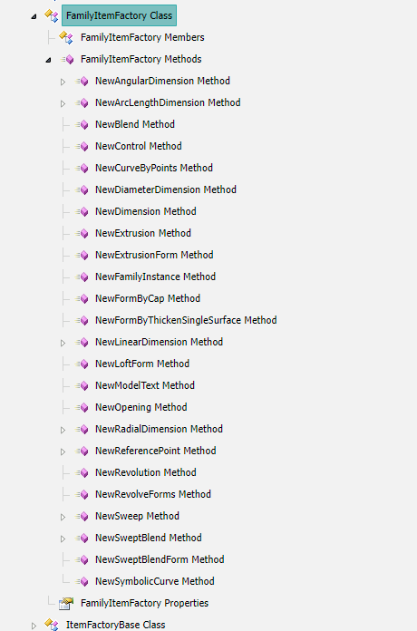
James Progress
Revit API Research
Relatively limited library for modeling directly objects via code.
Possible Paths Forward:
1. Rebuilding grasshopper code out into Revit script and run speech to text model to control it.
2. Train an LLM RAG to generate scripts which can be run to produce objects.
Not creating from blank, helping generate parameters to fill existing family template. “Autodesk Developer”

Slide 12
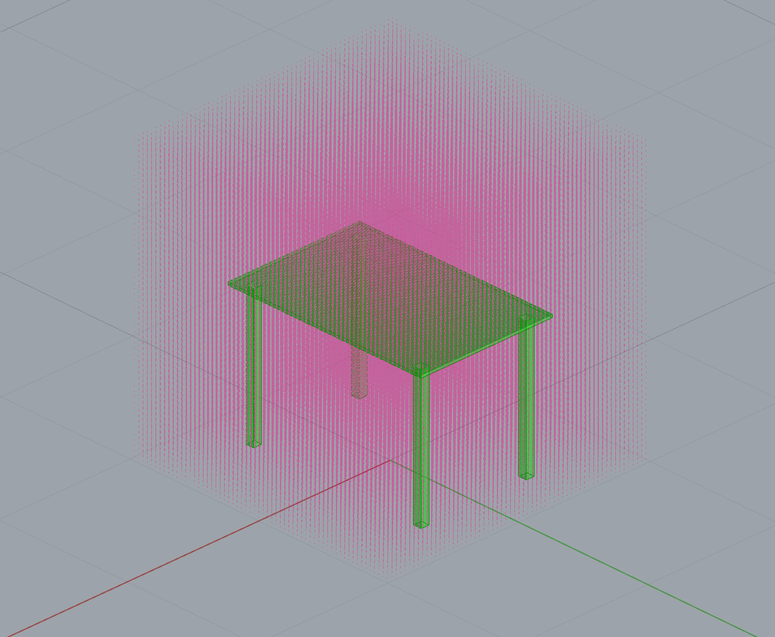
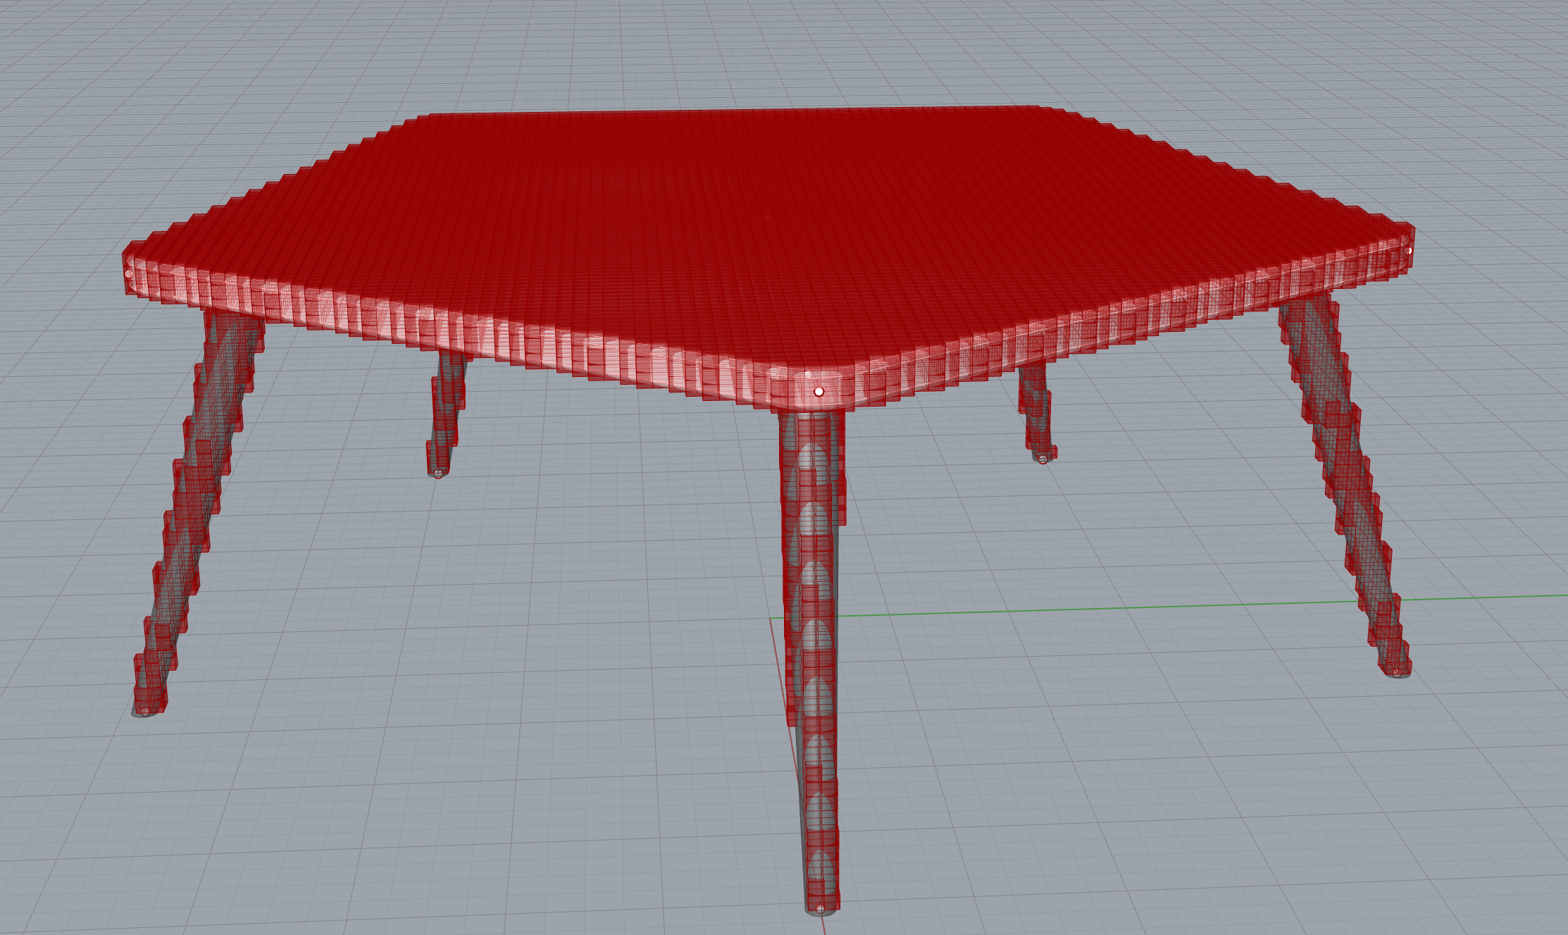
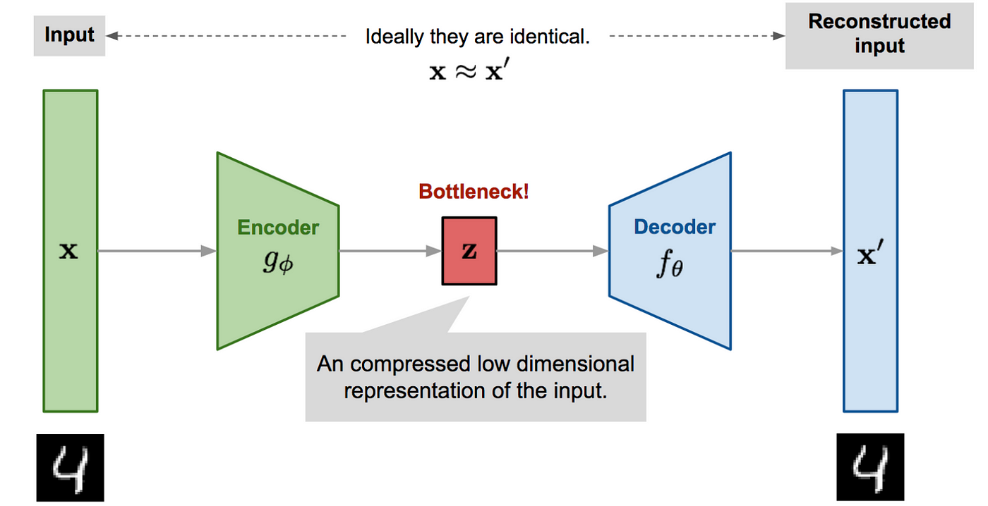
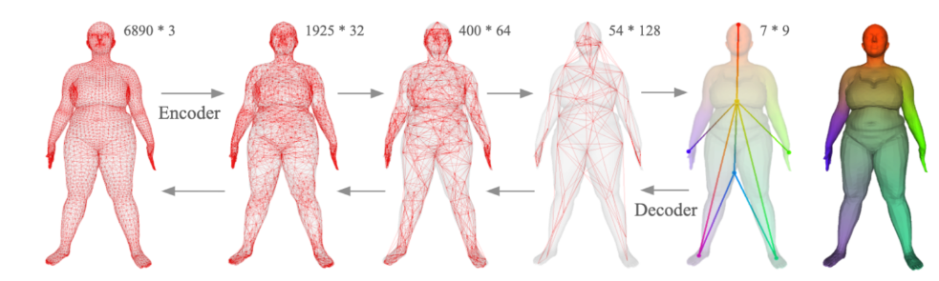
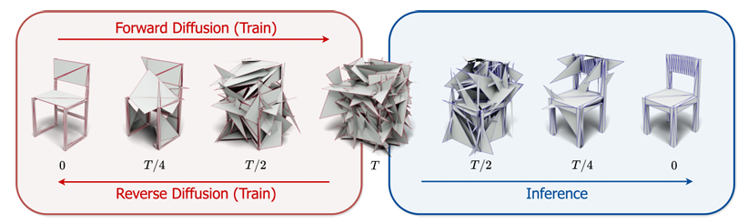
James Progress
3D Generation Research
Voxelized Autoencoder
Voxelize geometry and use 3D convulsion to compress and decompress each voxel as a ‘pixel’
Mesh GAE
Compress and uncompress a mesh into latent space using convolution based on vertex values and relationships.
Mesh Discrete Diffusion Denoiser
Add and remove noise over a time step to a mesh’s vertex values.
Mesh Latent Diffusion Denoiser?
Combine GAE and Diffusion to make a latent diffusion model
Reference:
https://zhouyisjtu.github.io/project_vcmeshcnn/vcmeshcnn.html
https://medium.com/@pooja_ravi/the-buzz-around-generative-ai-autoencoders-beaa199e49b2
Reference:
https://zhouyisjtu.github.io/project_vcmeshcnn/vcmeshcnn.html
https://medium.com/@pooja_ravi/the-buzz-around-generative-ai-autoencoders-beaa199e49b2

Slide 13
Week 2 / 3 Recap & Next Steps
Level 1 – Generate Model / Family Template
More Applied Technology Approach (Keep in Mind)
Don’t have to use Revit
GH works if Revit / Rhino.Inside is unrealistic
Choose / create an existing family model to set parameters
Work backwards in GH
Use something like AutoGPT to run it??
JSON to Revit Generation?
Level 2 – Train Model on Family Elements with Graphs
Build graph with Tensorflow instead of Pytorch?
Gabriella Notes:
Dom & James - Level 1: Feed an existing parametric model with JSON dictionaries - Level 2: Get the LLM to understand multiple elements, and their parameters and relations to each other, to feed into "multiple" mini parametric models - Document your trials, make many trials, and try to really scope out the limits of the tool. You might want to have a look at Embryo as a inspiration for meta-parametric modeling https://www.food4rhino.com/en/app/embryo
Revit API very limiting for modeling
Train LLM to generate models correctly? 3D model generation
Option 1
Continue with Revit API / Rhino.Inside approach for Family Creation
Need custom python code in Grasshopper
Short Lived?
Option 2
Use Created Speech to Prompt Notebook to generate usable 3D model
Rags model? Diffusion Model? Pytorch / Python
More challenging, Yes, but More rewarding

Slide 14
Current Phase

Slide 15
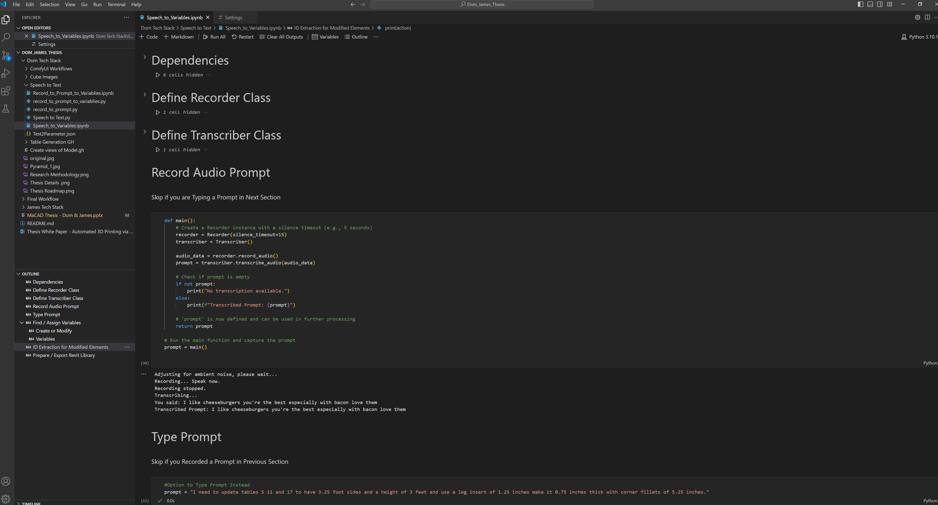
Dom Progress

Slide 16
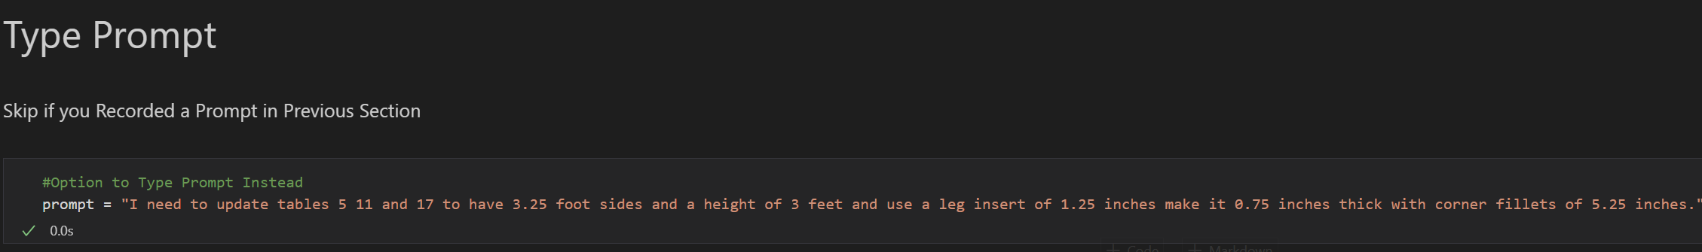
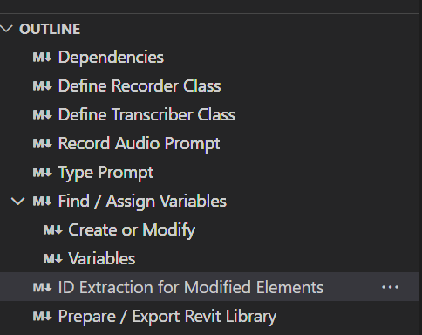

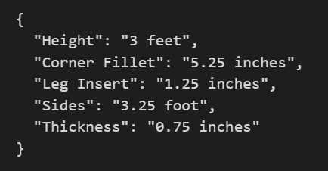
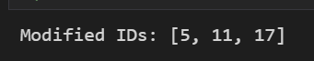

Dom Progress
Speech to Text Prompt - Python

Slide 17
James Progress
Revit API Research
Relatively limited library for modeling directly objects via code.
Possible Paths Forward:

Slide 18
Combined

Slide 19
Next Steps

